Slide 1

System Design & Analysis
PHASE FOUR
5.1.2024

Slide 2
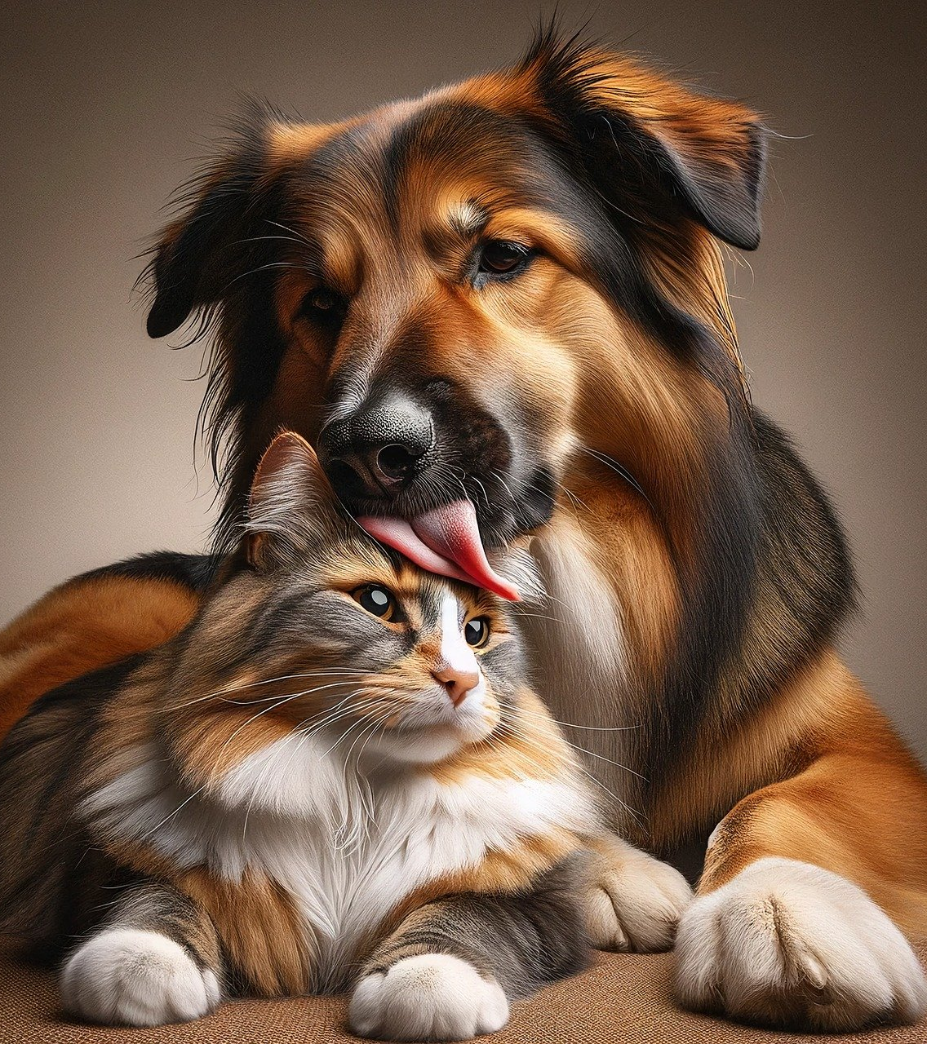
“We’re not to blame for your pet’s bad name”
PET NAMER
Would you like help picking
a name for your pet?
Simply upload a picture and
we’ll recommend a few
different names for you!

Slide 3
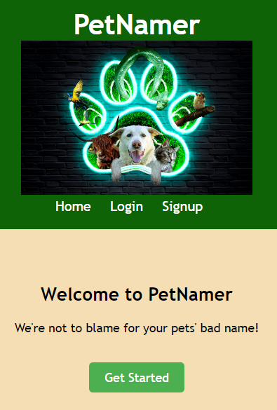
Gui Screenshot - landing page
When a pet owner IS NOT logged in, this is the home page.
Navigation bar links:
Home (current page)
Login (must already have an account)
Signup (create new account)
Page link:
Get Started (goes to login page)

Slide 4
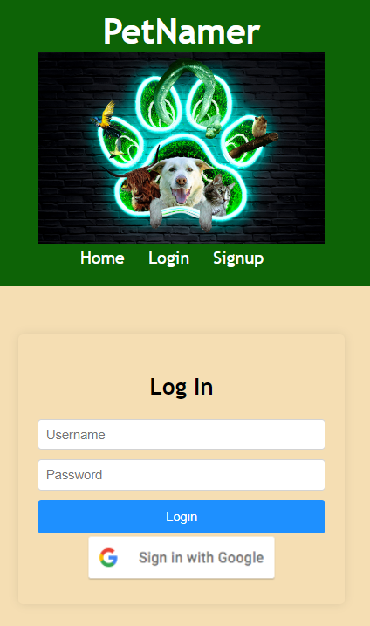
Gui Screenshot - login page
Navigation bar links:
Home (landing page)
Login (current page, must already have an account)
Signup (create new account)
Page links:
Login (when a pet owner already has an account)
Sign in with Google (a pet owner can use their Google account to log in)

Slide 5
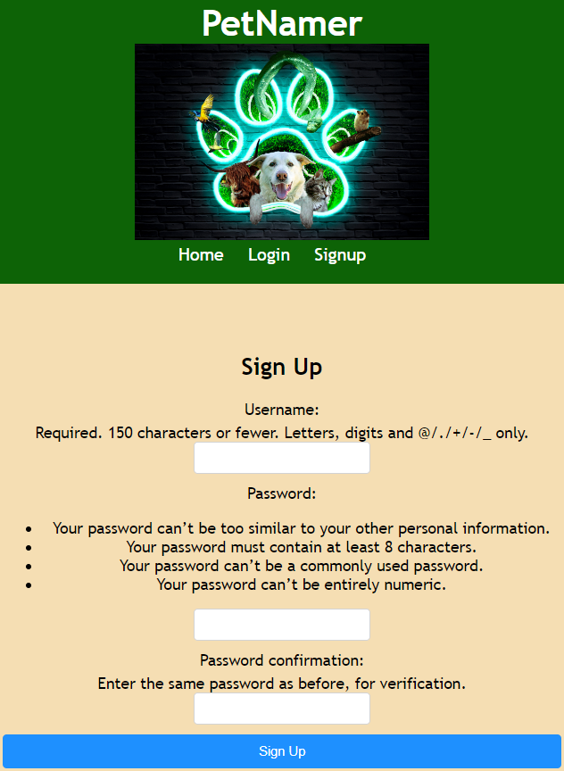
Gui Screenshot - signup page
Navigation bar links:
Home (landing page)
Login (current page, must already have an account)
Signup (current page)
Page link:
Sign Up (completes account creation, goes to the login screen)

Slide 6
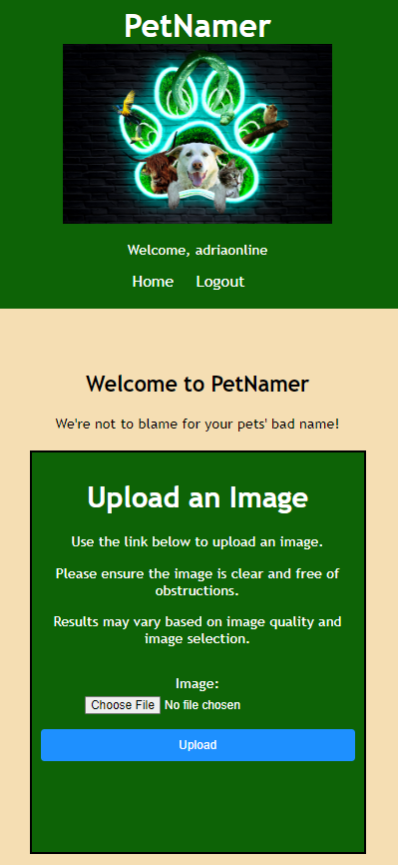
Gui Screenshot - upload image (home)
When a pet owner IS logged in, this is the home page.
Navigation bar links:
Home (landing page)
Logout (returns to the landing page)
Page links:
Choose File (opens local file system)
Upload (uploads file after one is selected)

Slide 7
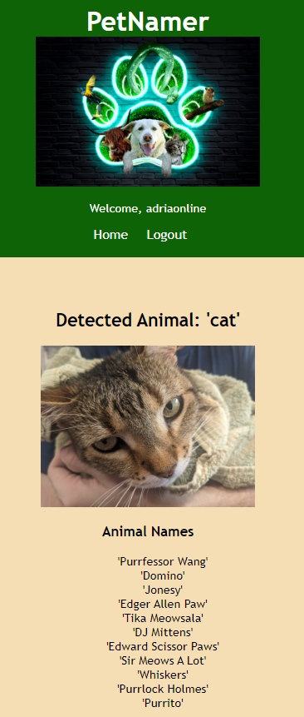
Gui Screenshot - Pet name suggestions
Navigation bar links:
Home (landing page)
Logout (returns to the landing page)
Page links:
None

Slide 8
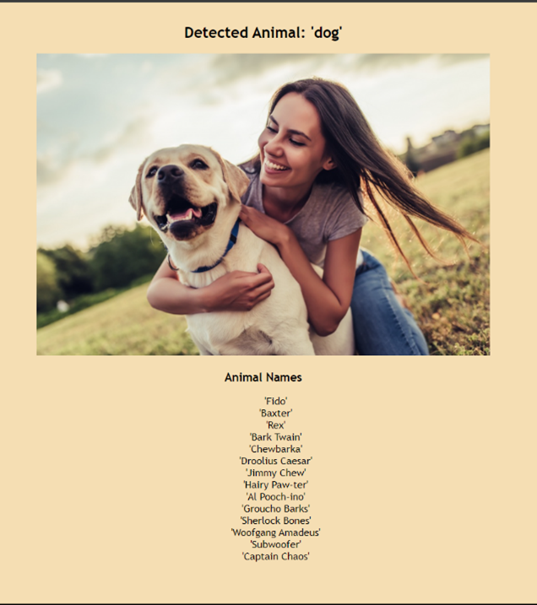
Test case #1
human & Dog
When uploading a picture of a person holding a dog, what will the program return?
Expected Result: Names will be returned correlating to the dog species. All other items recognized in photo will be ignored.
Result: As expected.
Potential Improvements: Remove quotation marks from name outputs and species output.

Slide 9
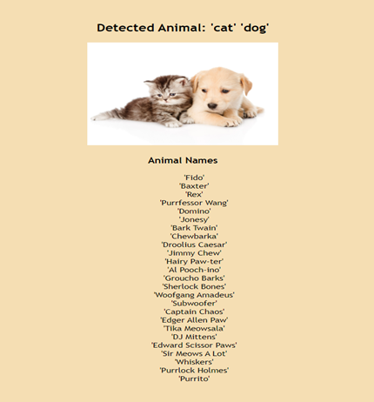
Test case #2
cat & Dog
When uploading a picture of a cat AND a dog in the same picture what will the program return?
Expected Result: Names will be returned correlating to both cats and dogs.
Result: As expected.
Potential Improvements: Separate name suggestions by species.

Slide 10
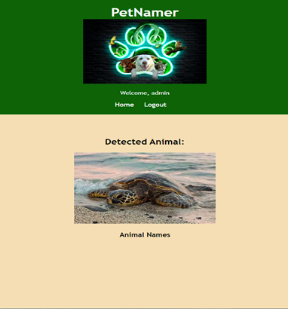
Test case #3
An animal not in the database
When uploading a picture of an animal not in our databases what will the program return?
Expected Result: A message stating nothing in the picture was recognized.
Result: The default layout without any species or suggested names.
Potential Improvements: Program a default statement stating that the animal was not recognized.

Slide 11

LIVE presentation
Team 1: Phase Three

